Slide 1
Create and troubleshoot your own DSC building blocks and “Make it so!”
Ben Gelens

Slide 2

Ben Gelens
Job : Consultant
MVP : CDM (PowerShell)
Company : inovativ
Email : ben@bgelens.nl
GitHub : bgelens
Twitter : @bgelens
Community : {Hyper-V.nu, azurestack.eu, DuPSUG}
Blogging : {Hyper-V.nu, PowerShellMagazine.com, azurestack.eu}

Slide 3
Agenda
Overview resources
Inbox Script Resource
Custom Script Resource Module
Custom Class Resource Module
Summary

Slide 4

DSC Resources
Inbox
Registry
File
Script
….
Resource Kit (x and HQRM)
Custom / Homebrew

Slide 5
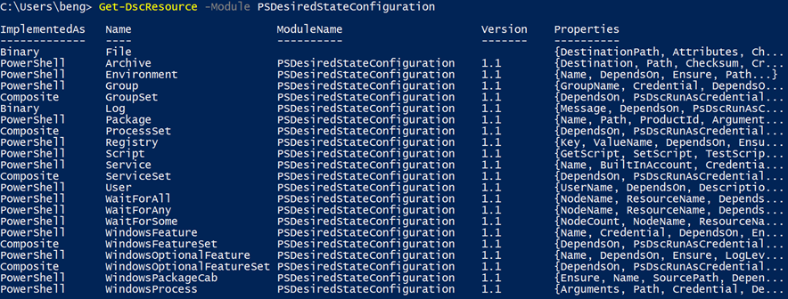
Inbox Resources

Slide 6
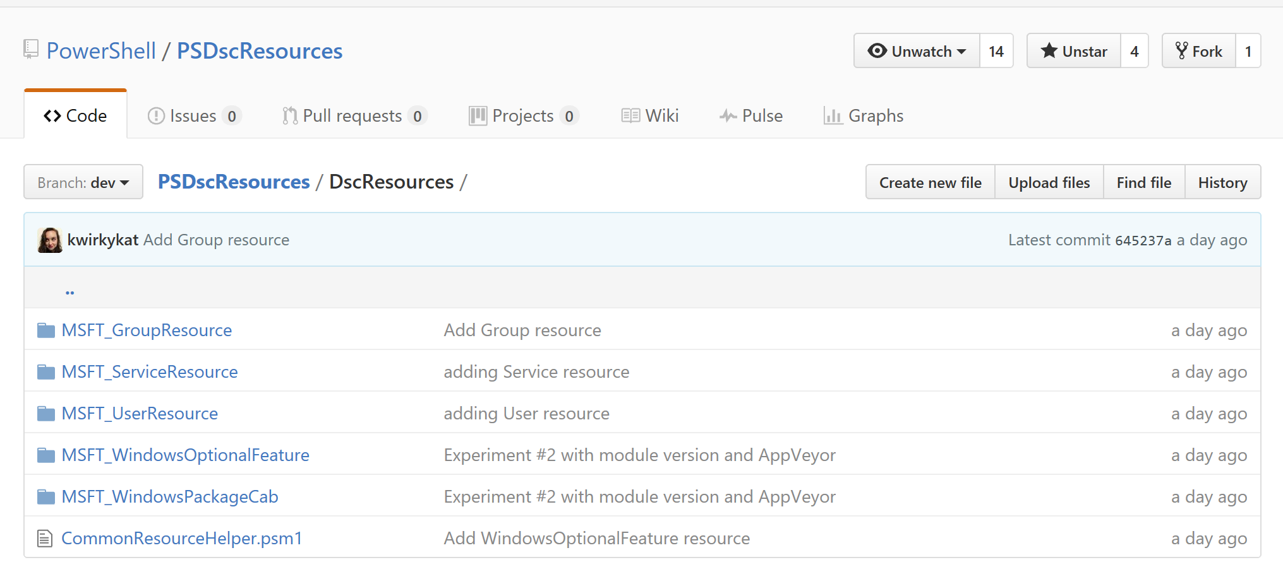
Inbox now OSS: PSDscResources
https://github.com/PowerShell/PSDscResources

Slide 7
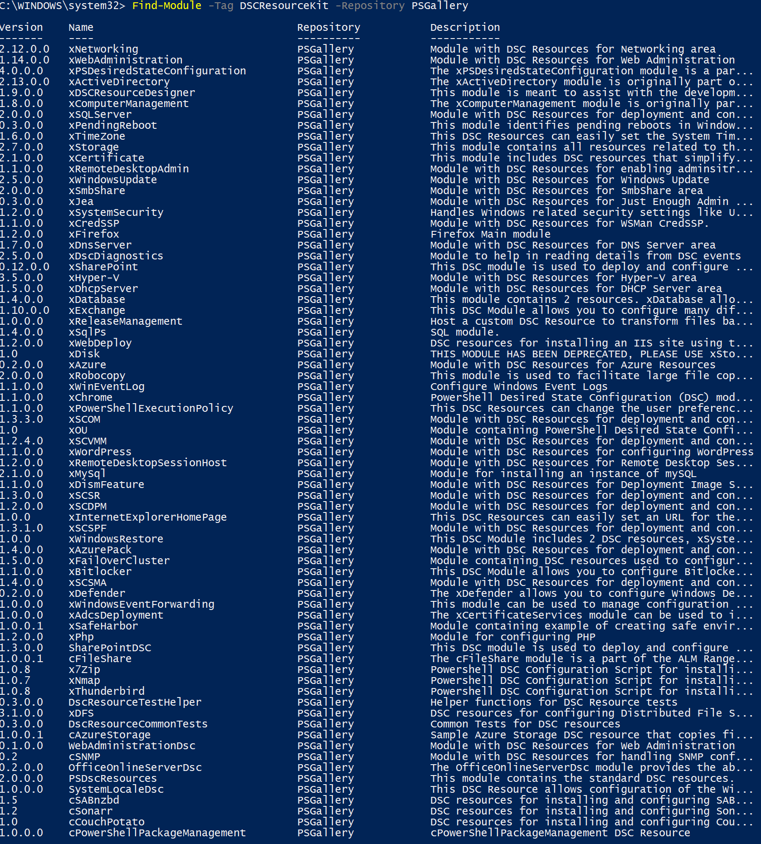
Resource Kit PSGallery

Slide 8
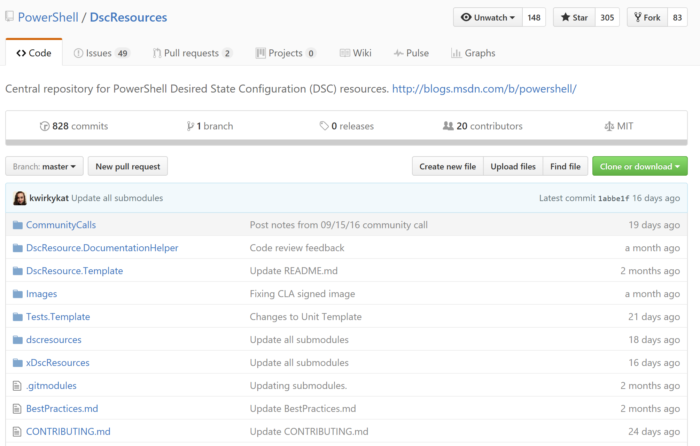
Resource Kit GitHub
https://github.com/PowerShell/DscResources

Slide 9
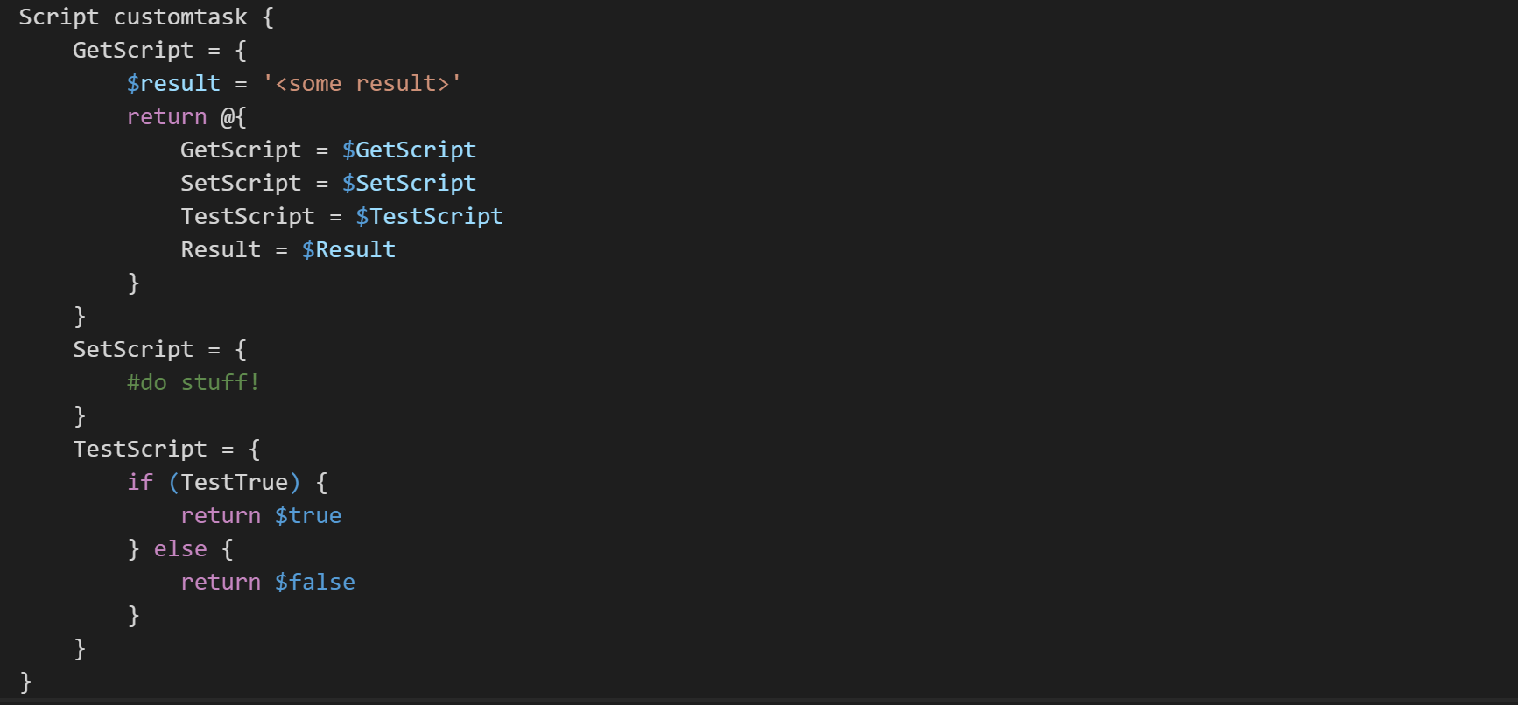
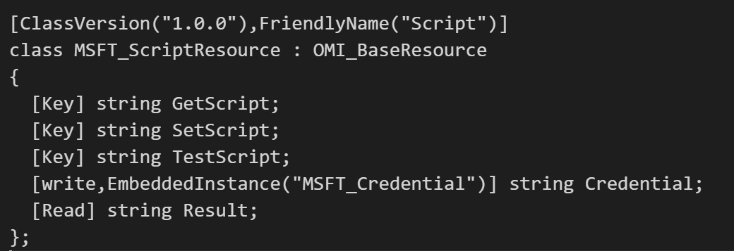
Script Resource
Notes:
Poorman resource. Used in Q&D PoC type scenrios (IMO)
If you specify something else in Get then Get,Set,Test or result. It will blow up when Get-DscConfiguration is called
If done correctly, might as well have build a Custom resource (investment would not be that much extra but value would be that much greater!)
Get should reflect schema
You should look at the schema as the syntax doesn’t reveal read only properties

Slide 10
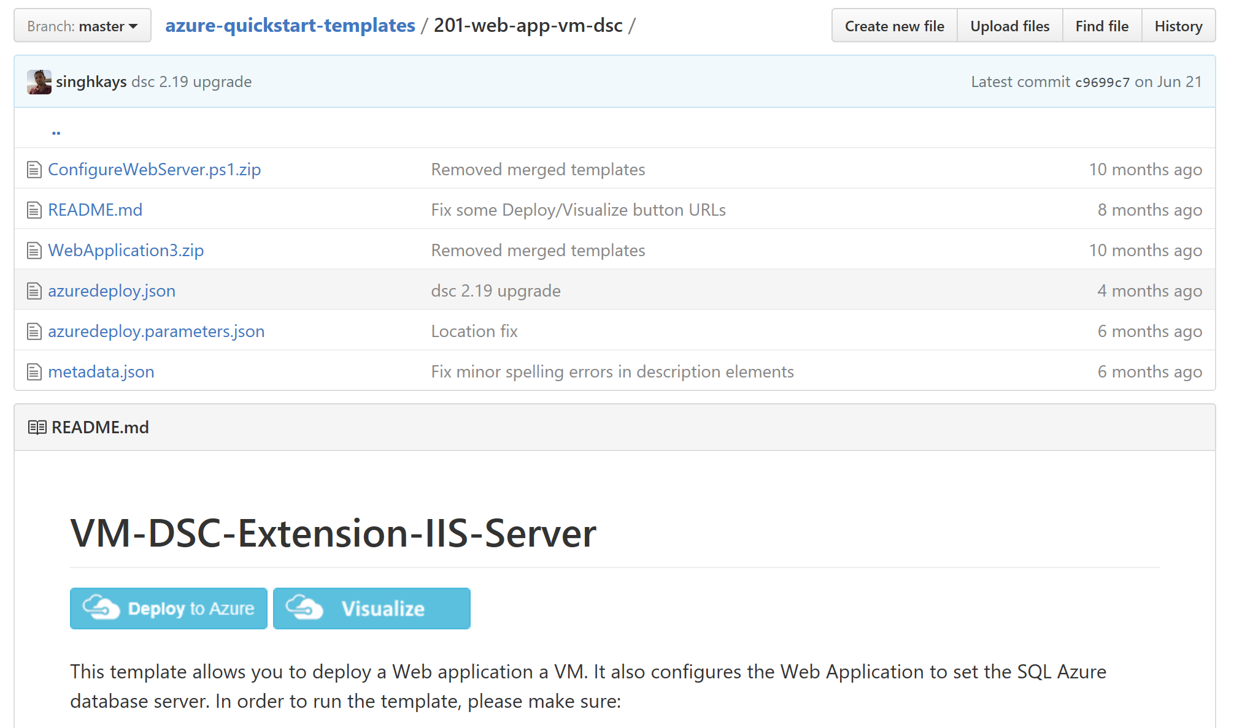
Bad examples all over the place
E.g. Look in Azure Template GitHub repo
Notes:
I am targeting this for this presentation not to bad mouth it but because it’s a highly used repo where people learn how to do things. And it was easy to find some examples.

Slide 11
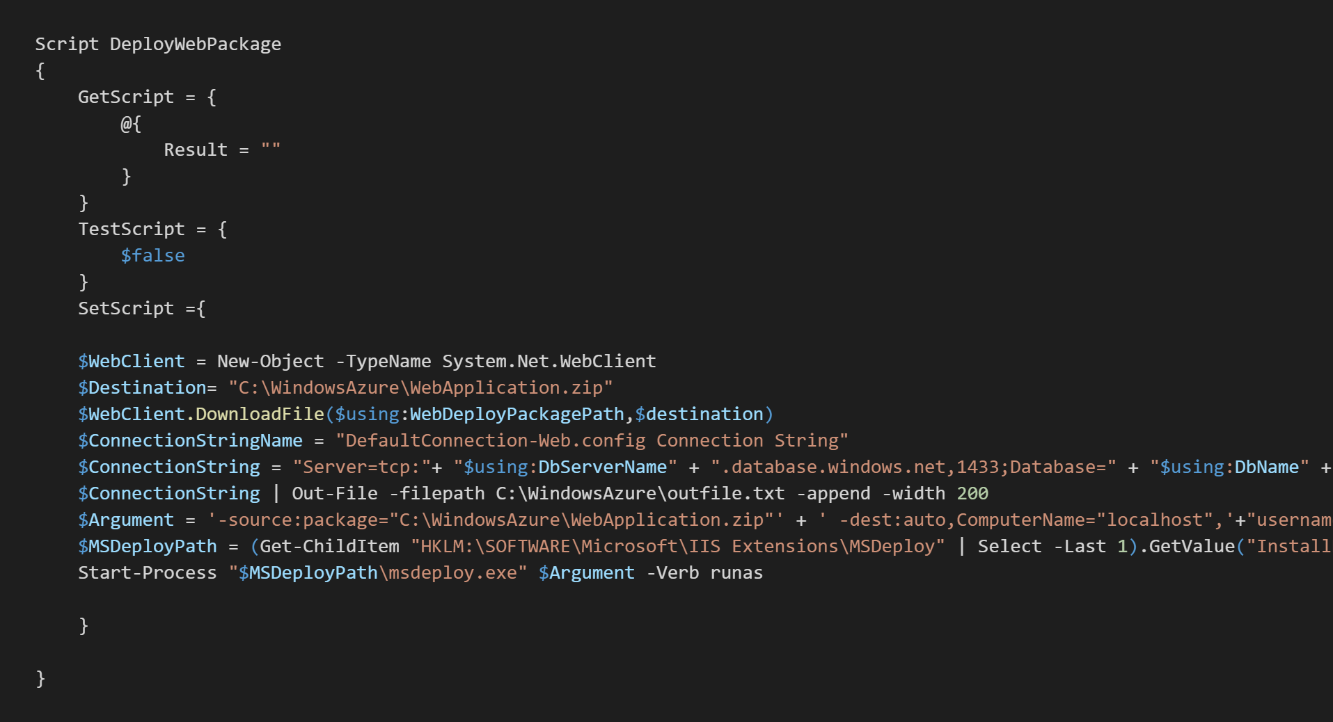
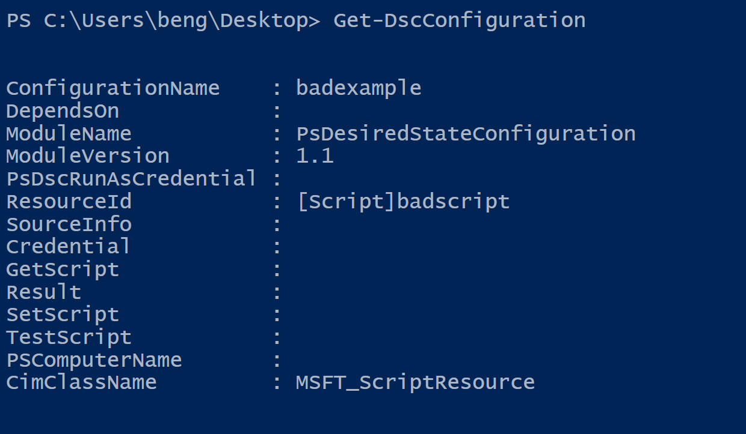
Is this any good?
Notes:
GetScript should return the current configuration of the node so you can investigate. Is this usefull?
TestScript always returns $false. What would happen if the LCM was in autocorrect mode?

Slide 12
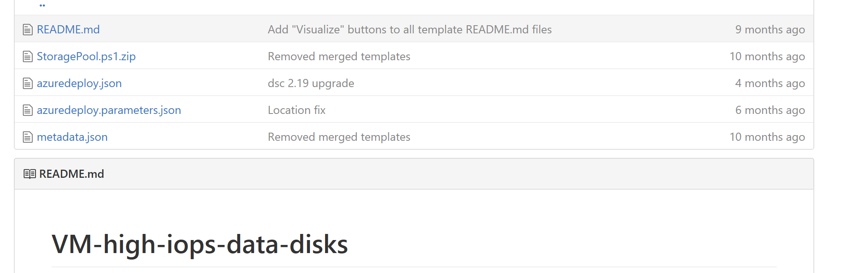
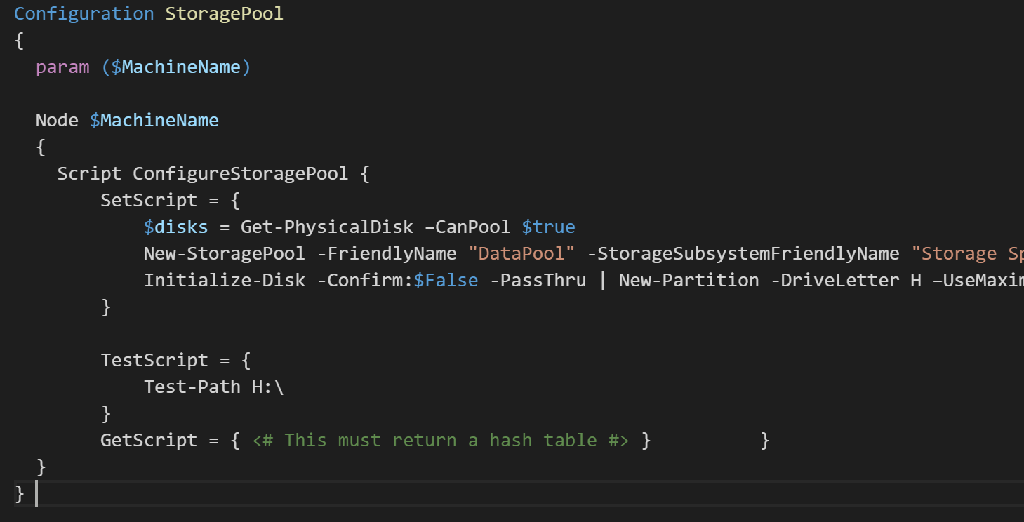
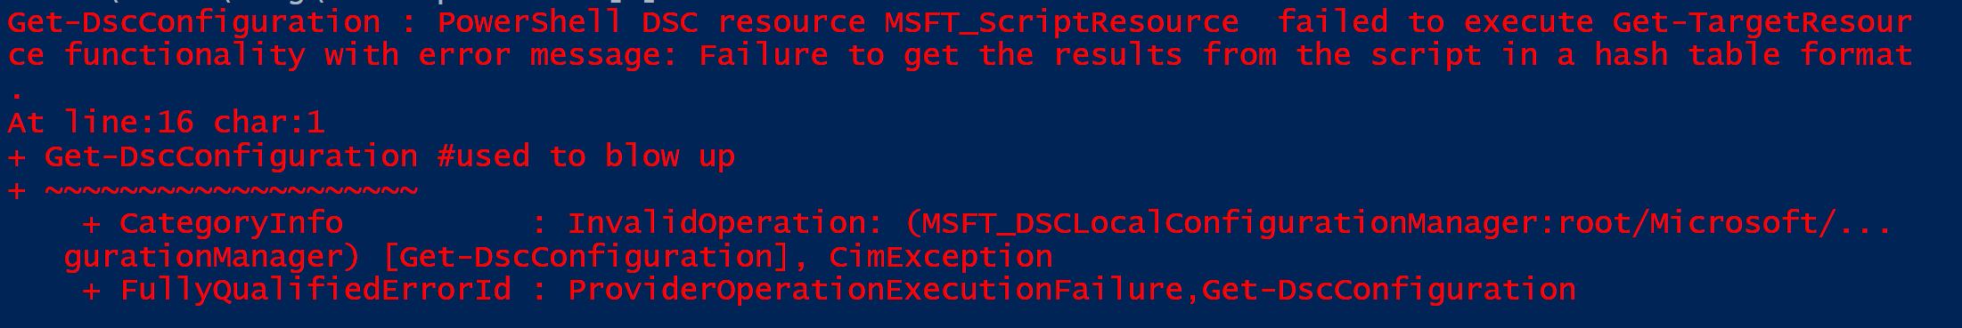
Notes:
Another random example.
Test-Path actually returns a bool, so this is fine.
GetScript has a nice note!

Slide 13
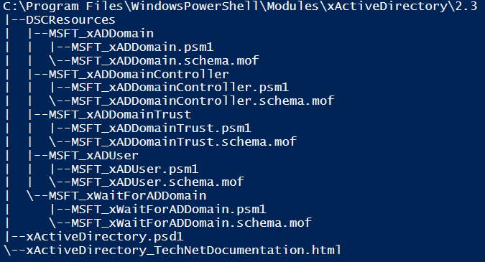
Custom Script Resource Module
Resources Directory
Module Directory
Version
DSC Resource
Resource Code
and MOF Schema
Manifest

Slide 14
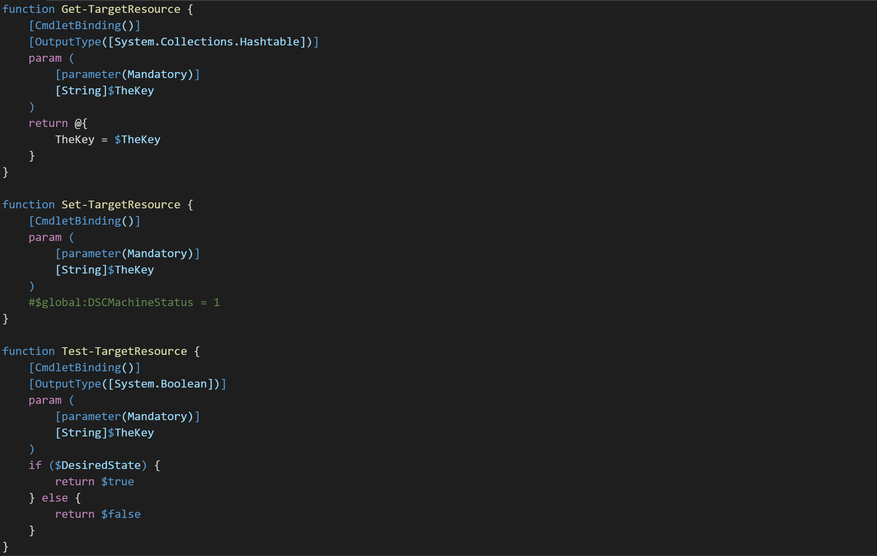
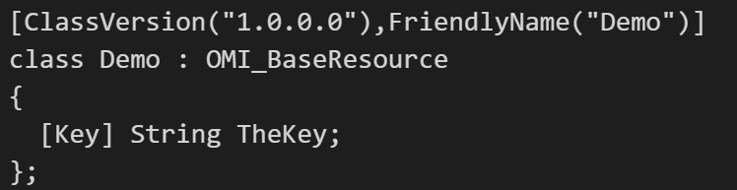
Resource Code:
Get
Set
Test
Schema.mof
Reboot Required?

Slide 15

Demo: Script Resource Module

Slide 16
Custom Class Resource Module
Manifest
Resources
Module Directory
Version
WMF 5+!

Slide 17
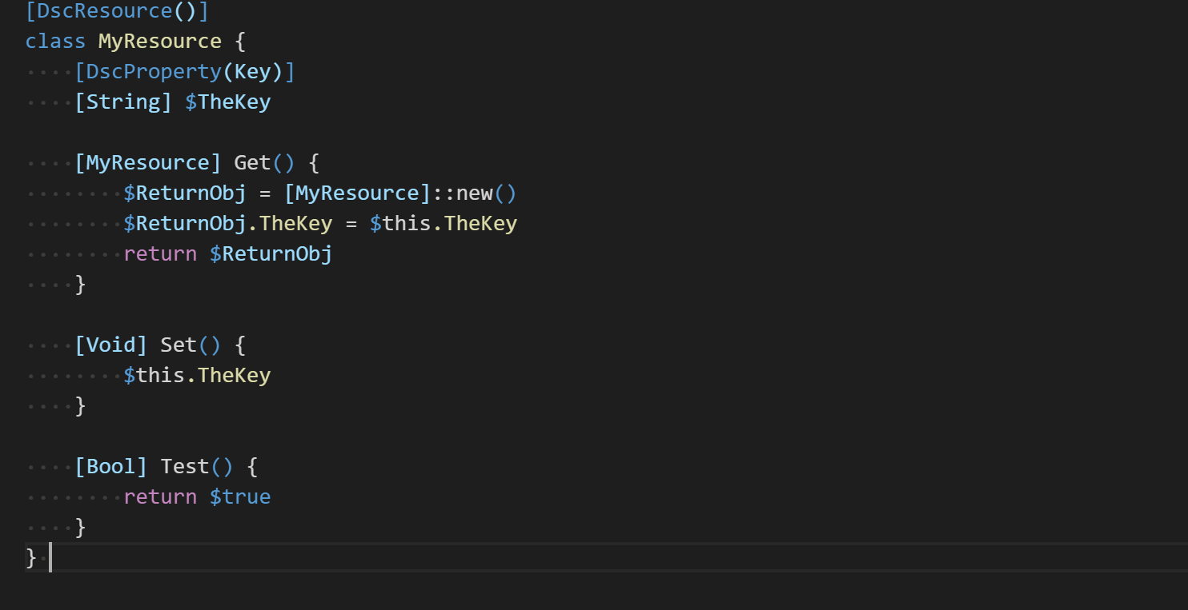
No Schema!
Generated on the fly
Resource Code:
Get
Set
Test

Slide 18
Demo: Class Resource Module

Slide 19
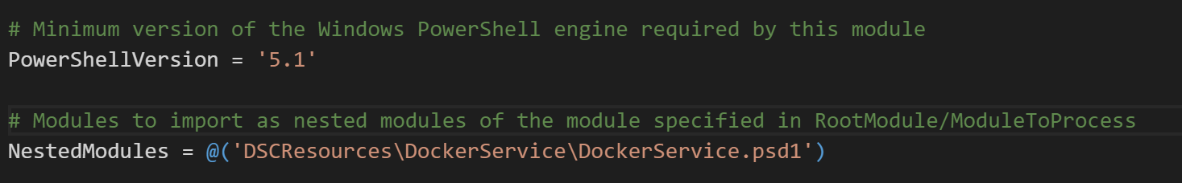
Combined Script and Class
New in WMF5.1
Class and script resources co-exist in same “Parent” module
No downlevel support

Slide 20
Summary
Use inbox -> Resource Kit -> Custom Resource
Make attempt to contribute your custom resource to community (IP won’t make DSC better!)
Only Use Script Resource for Q&D if you can
Use Script Resource Module if WMF4 can be targeted
Use Class Resource Module for new tech
Use Pester Unit and Integration Tests for higher Quality
Combined script and class resources for WMF5.1+ only

Slide 21
Summary
Debug
Import psm1
Verbose!
own user credentials
best for Unit testing
LCM Debugging
Debugger
Runs as system
Step by step tracking

Slide 22
<Volgende sessie 16:00 – 17:00 uur>
Premium Management and Protection of Identity and Access with Azure AD (EN)
Jan Vidar Elven

